Slide 1

Credit Scoring
Default in two years?

Slide 2
01
Key Problem
Topic: Credit Scoring
Goal: To improve credit scoring mechanism and predict whether a person may become delinquent for over 90 days in next two years
Significance:
Important for banks to predict the possibility of default accurately in order to prevent loss

Slide 3
02
Dataset
Dataset from Kaggle: “Give me some credit”
Dependent variable: “SeriousDlqin2yrs”
(1- delinquency, 0- no delinquency)
Independent variables: 10 variables
Training set
80546 entries
Test set
10890 entries
Age
DebtRatio
MonthlyIncome
NumberOfDependents
NumberOfTimes90DaysLate
NumberRealEstateLoansOrLines
NumberOfOpenCreditLinesAndLoans
RevolvingUtilizationOfUnsecuredLines
NumberOfTime60-89DaysPastDueNotWorse
NumberOfTime30-59DaysPastDueNotWorse

Slide 4
02
Data Cleaning
Missing Values:
Drop rows with two or more columns of missing values
Outliers:
Fill with 95th quantile
Significant Data Imbalance:
For training set
Originally: 100683 (y=0) vs 7450 (y=1)
Oversampling (SMOTE) and undersampling: 40273 (y=0) vs 40273 (y=1)

Slide 5
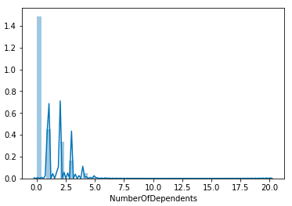
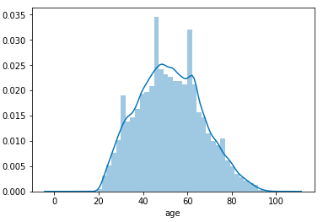
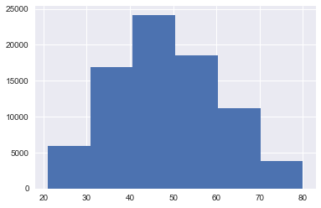
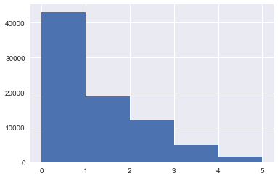
02
Data Cleaning
Age
Number of Dependents

Slide 6
03
Model Selection
From Literature Review
Logistic Regression
K-Nearest Neighbour
Neural
Networks
Decision
Trees
From competitors on Kaggle:
Gradient Boosting
Random forest

Slide 7
03
Model Training — Classification
Logistic Regression
Adaptive boosting
Gradient Boosting
Overall Accuracy Score
Stacking
ROC curve & AUC score
Random Forest
Classification Tree
Precision & Recall
Naive Bayes (GaussianNB)
K-Nearest Neighbors
Neural Network

Slide 8
03
Model Performance
Logistic Regression (Baseline)
Robust Scaler to transform X
Lasso (L1): parameter: C=0.0158
AUC Score
Train: 0.8798 Test: 0.5264
Accuracy
Train: 0.7933 Test: 0.4914
Precision: 0.4785, Recall: 0.1953
Ridge (L2): parameter: C=0.0019
AUC Score
Train:0.8804 Test: 0.5261
Accuracy
Train: 0.7933 Test: 0.4935
Precision: 0.4829, Recall: 0.1866
SUMMARY
Similar performance of Lasso and Ridge
Poor test performance
Close to random guess

Slide 9
Top Models

Slide 10
03
Model Performance
Adaptive boosting
GridSearch
Parameters: n_estimators=2000, learning rate=1.3
AUC Score
Train: 0.9734 Test: 0.8923
Accuracy
Train: 0.9237 Test: 0.8570
Test performance improves after tuning
Before tuning (n_estimators=200, learning rate=0.5)
AUC Score: 0.8102 (Test)
Accuracy: 0.7480 (Test)
SUMMARY
Efficient GridSearch
Fewer parameters to tune
Good performance in both AUC and accuracy

Slide 11
03
Model Performance
Gradient Boosting
GridSearch
Parameters: max_depth=5, min_samples_split=4, n_estimators=391, subsample=1.0
AUC Score
Train: 0.9828 Test: 0.8831
Accuracy
Train: 0.9412 Test: 0.8464
SUMMARY
Many parameters to tune
Computationally expensive

Slide 12
03
Model Performance
Stacking
Integrating two top performing models: Adaptive Boosting & Gradient Boosting; basic Logistic Regression as meta model
AUC Score
Train: 0.9410 Test: 0.8618
Accuracy
Train: 0.9385 Test: 0.8510
Precision: 0.9176, Recall: 0.4531
SUMMARY
Similar performance as Adaptive Boosting, only slimly worse
Possibly a little too complex here

Slide 13
03
Model Performance
Random Forest
GridSearch
Parameters: n_estimators=900, max_depth=110, max_features='auto', min_samples_leaf=1, min_samples_split=5, bootstrap=False
AUC Score
Train: 0.9999 Test: 0.8495
Accuracy
Train: 0.9999 Test: 0.7858
Test performance improves a lot after tuning
Before tuning (n_estimators=300, max_depth=5)
AUC Score: 0.6885 (Test)
Accuracy: 0.5967 (Test)
SUMMARY
Significant improvement after tuning
Takes up a lot of time and computing power
e.g. 5400 fits takes
more than 10 hours

Slide 14
03
Model Performance
Classification Tree (DecisionTreeClassifier)
X covariates using RobustScaler
Default model parameters: max_depth=None, min_samples_split=2, min_samples_leaf=1
Accuracy
Train: 0.99996, Test: 0.7436
AUC Score
Train: 0.99999, Test: 0.7446
Precision: 0.8032, Recall: 0.4339
After tuning: single parameter tuning: min_samples_split = 80
Accuracy: Train: 0.9227, Test: 0.7653
AUC Score: Train: 0.9799, Test: 0.7673
Precision: 0.8682, Recall: 0.4087
SUMMARY
A lot Better
compared to Logistic Regression models
Slightly improved after parameter tuning

Slide 15
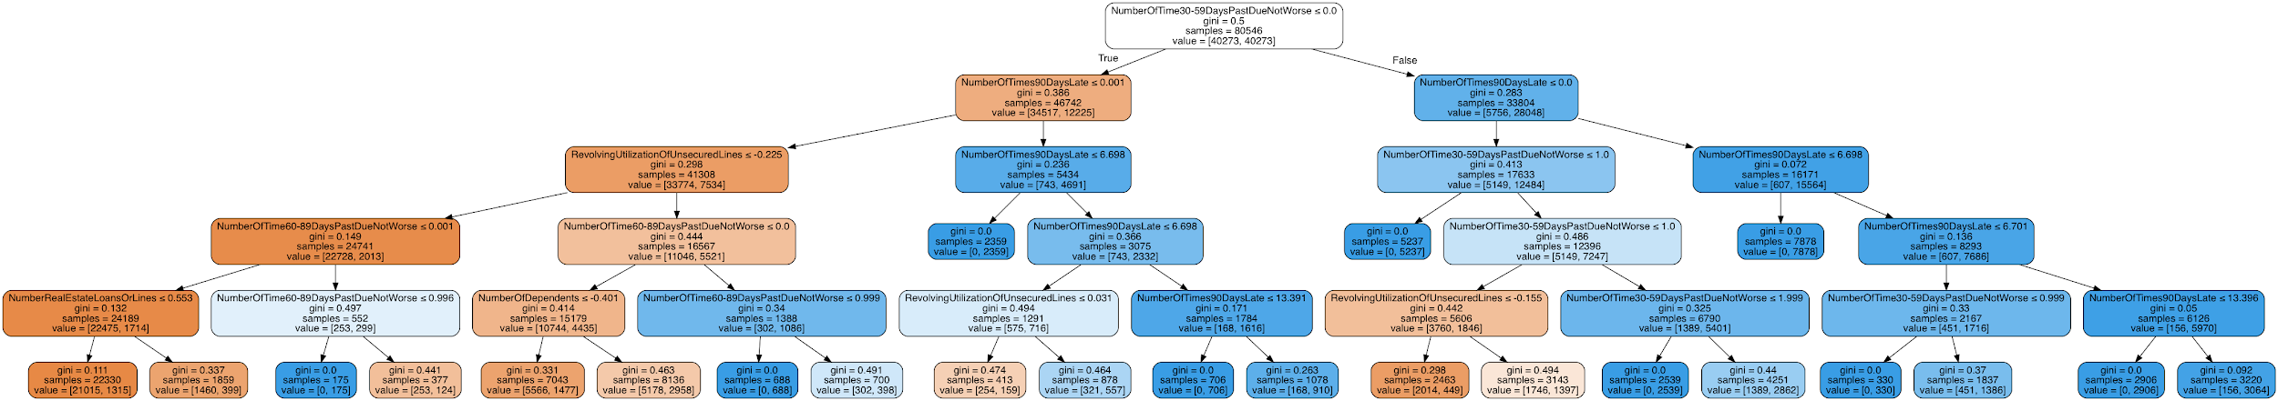
03
Model Performance
Classification Tree (DecisionTreeClassifier)
Insights About Covariate Significance

Slide 16
Other Models we tried

Slide 17
03
Model Performance
Naive Bayes (GaussianNB)
X covariates using RobustScaler
Default model parameters:
Accuracy
Train: 0.7452, Test: 0.4952
AUC Score
Train: 0.8672, Test: 0.5405
Precision: 0.4781, Recall: 0.1051
Not accepting parameters for tuning
Underlying independence assumptions: suppose the underlying likelihood of the real input features are of Gaussian distribution
SUMMARY
KEYWORD
Potentially strong prior assumptions; not necessarily hold here
Similar results to Logistic regression, generally not performing well

Slide 18
03
Model Performance
K-Nearest Neighbour (KNeighborsClassifier)
Neural Network (Sequential model)
X covariates using RobustScaler
Default model parameters: n_neighbors = 5
Accuracy
Train: 0.9050, Test: 0.5446
AUC Score
Train: 0.9726, Test: 0.5641
Precision: 0.5987, Recall: 0.2485
A 5-dense-layer neural network with ReLU activation function and L2 regularization
Default model:
Accuracy
Train: 0.8270, Test: 0.5185
AUC Score
Train: 0.8965, Test: 0.5495
SUMMARY
KEYWORD
Slightly better
than Logistic regression
Slow processing and high demanding of computing power

Slide 19
04
Conclusion
Overall Performance Comparison
Logistic Regressions
(Gaussian) Naive Bayes
Neural Network
KNN
Classification Tree
Random Forest
Stacking
Gradient Boosting
AdaBoost
Accuracy, AUC Score, Precision & Recall
0.86 Accuracy,
0.89 AUC,
Small gap between training and testing score (less overfitting)
KEYWORD
Lower
Higher
Insights & Interpretations
Tree-based models: very powerful, especially when they are combined; also, easier to understand and provide inspiring insights -> banks may consider using adaboost or boosting models further joined together to enhance their overall prediction accuracy of potential borrowers’ loan default in the near future, improve their effectiveness of credit scoring, and thus reduce risk
Most important features to take into account: Historical data on previous default behavior (in the recent past); necessary to not only focusing on similar serious default behavior (90 days past due), but also considering the possibility of escalation: a person with minor or moderate default behaviors previously may degenerate into a worse offender along the time, given the number of previous defaults and other demographic information or household circumstances
Some features appear to be less significant in general, such as debt ratio, monthly income and number of open credit lines
Possible key issue: find internal relationships for detecting certain abnormal pattern which reflects the discrepancy between a person’s or a household’s income level and the consumption habits/lifestyles, instead of staying restricted to one aspect

Slide 20
05
Potential Improvement
Try other models & Find more useful features: e.g. SVMs & discriminant analysis; data not included originally: gender, occupation etc.
01
Tuning Improvement & Scoring Function: more precise consideration for features to tune; custom scoring objection function of recall for training
02
03
Feature Engineering: Instead of directly using the covariates, may consider create some features by ourselves.
04
Data Cleaning method: may apply better methods such as KNN to deal with the data.

Slide 21
THANK YOU!
Any Questions?
References
B Baesens, T Van Gestel, S Viaene, M Stepanova, J Suykens & J Vanthienen
(2003) “Benchmarking state-of-the-art classification algorithms for credit scoring”, Journal of the Operational Research Society, 54:6, 627-635, DOI:
10.1057/palgrave.jors.2601545
Kocenda, Evzen, and Martin Vojtek. “Default Predictors and Credit Scoring Models for Retail Banking.” SSRN, 7 Dec. 2009, papers.ssrn.com/sol3/papers.cfm?abstract_id=1519792.

